Slide 1





BACKEND CONCEPTS
Which covers Primary & Secondary Topics
Kanishka Ganesan

Slide 2



Introduction
This presentation covers modern backend and API development concepts.Topics include Node.js, RESTful APIs, Authentication, Testing, WebSockets, Database Design, Cloud Deployment, System Design, and AI API integration. Objective: To understand how to design, develop, test, and deploy scalable APIs, including integrating them with AI-powered workflows.

Slide 3
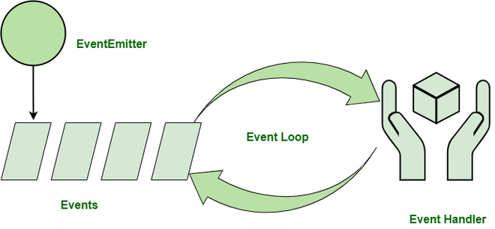
Node.js
Event-driven Architecture
Definition: A software design pattern where system components react to events asynchronously rather than executing tasks sequentially.
Key Components:
Event Producer: Generates events . (e.g., user action, sensor data).
Event Channel / Bus: Transports events. (e.g., Kafka, RabbitMQ).
Event Consumer: Listens and reacts to events
(e.g., updates DB, sends notifications).
Benefits:
Asynchronous & responsive
Highly scalable
Decouples producers & consumers
Example:
Order placed → “OrderPlaced” event → Payment service processes payment, Inventory updates stock

Slide 4
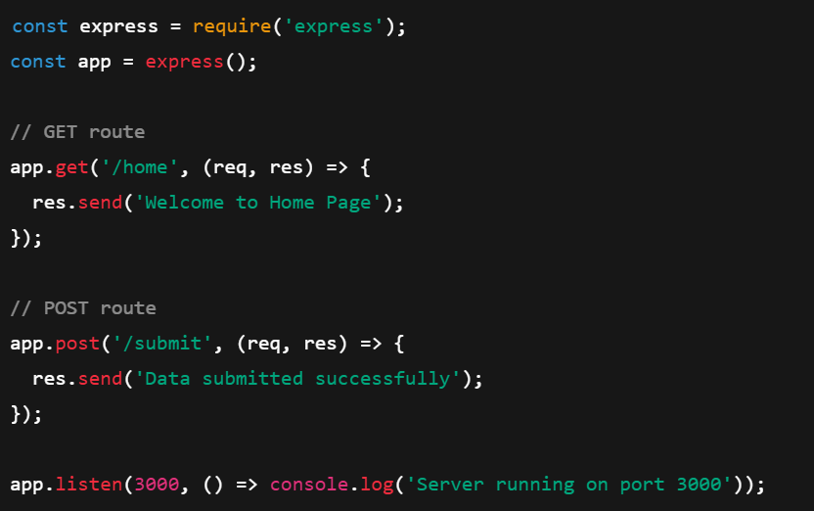
Express.js
Routing
Definition: Routing determines how an application responds to client requests at specific endpoints (URLs) with a defined HTTP method.
Key Points:
Each route has a path, HTTP method, and callback function.
Keeps application organized
Example:

Slide 5
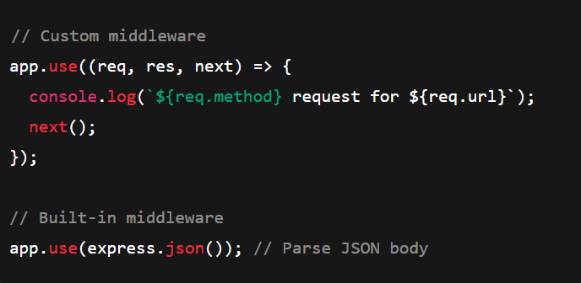
Express.js
Middleware
Definition: Middleware functions are functions that have access to the request (req), response (res), and next() function in the application’s request-response cycle.
Types of Middleware
1. Application-level: Bound to an app instance using app.use().
2. Router-level: Works with specific routers.
3. Built-in: Provided by Express, e.g., express.json(), express.static().
4. Error-handling: Handles application errors.
5. Third-party: External libraries, e.g., morgan, cors, helmet.
Uses:
Logging requests
Authentication
Error handling
Parsing request bodies
Example :

Slide 6
RESTful APIs in Java (Spring Boot)
HTTP Methods :
Definition : A RESTful API in Java (using Spring Boot) allows clients to interact with server-side resources using standard HTTP methods, each corresponding to a CRUD operation.
HTTP Methods :
Method | CRUD Operation | Description | Spring Boot Annotation
GET | Read | Fetch data from server | @GetMapping
POST | Create | Add new resource | @PostMapping
PUT | Update (Replace) | Replace existing resource | @PutMapping
PATCH | Update (Modify) | Partially update a resource | @PatchMapping
DELETE | Delete | Remove a resource | @DeleteMapping

Slide 7
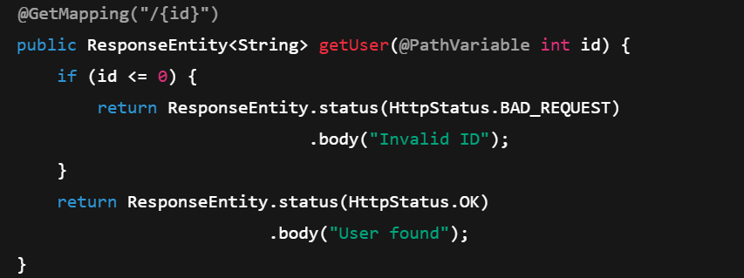
RESTful APIs in Java (Spring Boot)
HTTP statuscode
Definition: Status codes indicate the result of a client’s request — success, client error, or server error.
HTTP Status code :
Category | Code Range | Meaning | Example
✅ Success | 200–299 | Request processed successfully | 200 OK, 201 Created
🔄 Redirection | 300–399 | Client must take additional action | 301 Moved Permanently, 304 Not Modified
⚠️ Client Error | 400–499 | Problem with client request | 400 Bad Request, 404 Not Found
❌ Server Error | 500–599 | Problem with server | 500 Internal Server Error
Example :

Slide 8
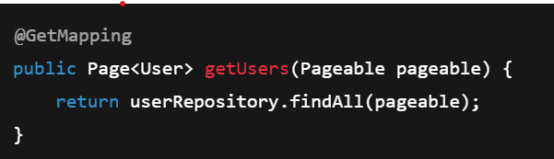
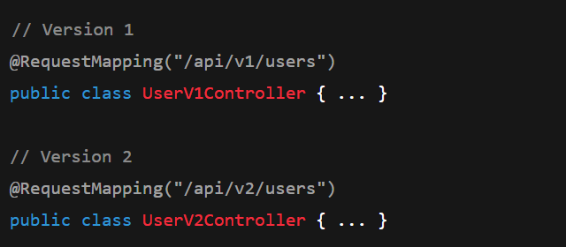
RESTful APIs in Java (Spring Boot)
Pagination
Definition: Pagination is used to limit and divide large datasets into smaller, manageable chunks — improving performance and user experience.
Example :
Versioning
Maintains backward compatibility when API changes.
Allows multiple versions to run simultaneously.
Example :

Slide 9
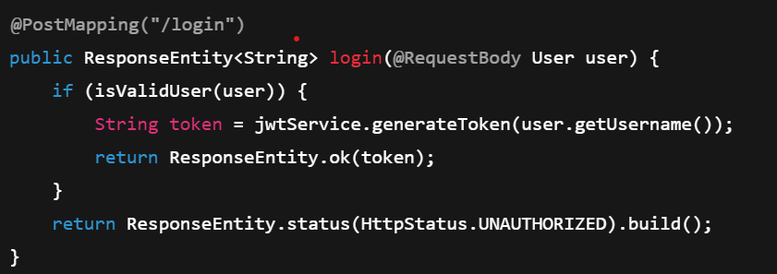
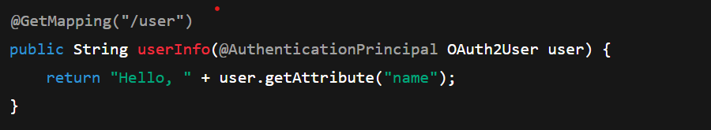
Authentication & Authorization → JWT, OAuth2
JWT (JSON Web Token)
Compact, stateless token for secure user authentication
Format: Header.Payload.Signature → xxxxx.yyyyy.zzzzz
Flow:
1. User logs in → credentials validated
2. Server issues JWT → client stores it (localStorage)
3. Client sends token in Authorization header
4. Server verifies before access
Example :
OAuth2 (Open Authorization 2.0)
Delegated authorization for third-party access
Used in “Login with Google/Facebook”
Flow:
1.User authenticates via provider (Google)
2. Provider returns access token
3. App uses token to access limited data
Example :

Slide 10
Testing APIs → Postman, Jest, Super test
Postman
GUI tool to send HTTP requests & inspect responses.
Supports GET, POST, PUT, DELETE.
Add headers, JSON body, run collections.
Jest
Used for unit & integration testing in Node.js.
Zero setup, mocking, snapshot tests.
SuperTest
Works with Jest to test API endpoints directly.
Tool | Type | Best For
Postman | Manual | Functional Testing
Jest | Automated | Logic/Unit Testing
SuperTest | Automated | API Endpoint Testing

Slide 11
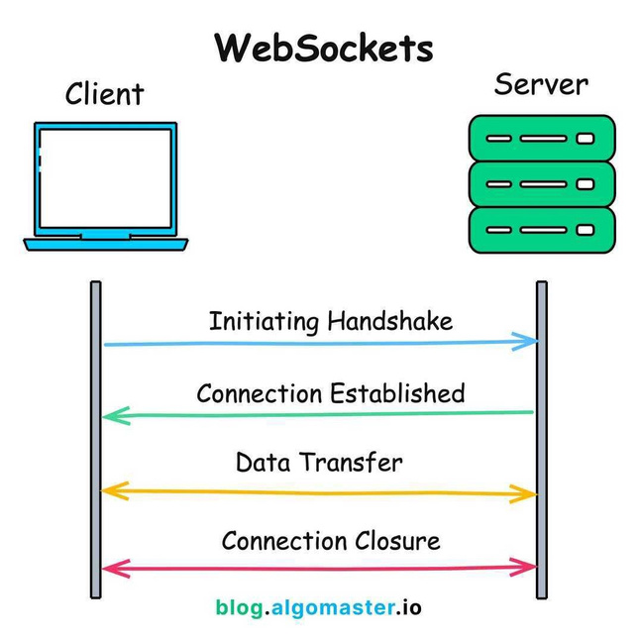
WebSocket → Real-time communication
A two-way, full-duplex communication protocol enabling real-time data exchange between client and server over a single, persistent connection.
✅ Unlike HTTP (request–response), WebSocket stays open — perfect for chat, gaming, live updates, stock feeds, etc.
How It Works
Handshake → Client requests upgrade (ws:// / wss://)
2. Connection Established → Server upgrades to WebSocket
3. Full Duplex → Both can send data anytime
4. Close → Either side can end the connection
In real-time

Slide 12

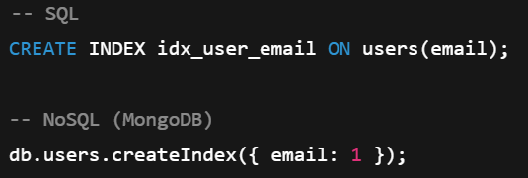
Database Design → SQL vs NoSQL, indexing
SQL VS NoSQL
Feature | SQL (Relational) | NoSQL (Non-Relational)
Structure | Tables (rows, columns) | Collections, Documents, Key-Value
Schema | Fixed / Predefined | Dynamic / Flexible
Query Language | SQL | JSON / API-based
Scalability | Vertical | Horizontal
Examples | MySQL, PostgreSQL | MongoDB, Cassandra
Best For | Structured data, ACID | Unstructured, scalable data
Indexing
An index is a data structure that speeds up data retrieval by avoiding full scan

Slide 13
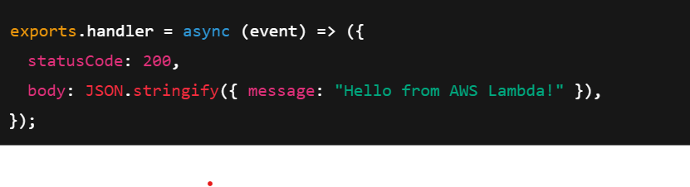
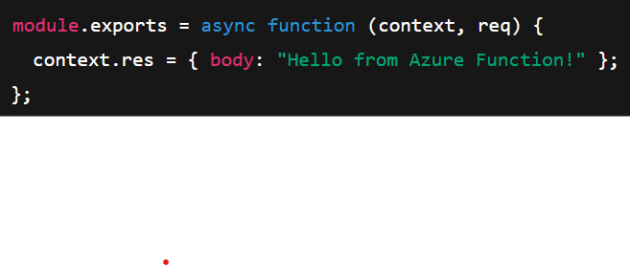
Cloud Basics → Deploy APIs using AWS Lambda / Azure Functions
Cloud Deployment
Hosting APIs/applications on cloud platforms (AWS, Azure, GCP) instead of local servers.
Ensures scalability, high availability, and cost efficiency.
AWS Lambda (Serverless Deployment)
Run backend code without managing servers.
Scales automatically and charges only for execution time.
Azure Functions (Microsoft Cloud)
Azure Function is a serverless, event-driven compute service by Microsoft Azure that lets you run small pieces of code (functions) without managing servers.

Slide 14
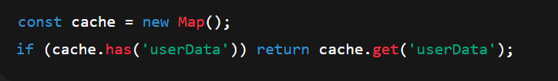
System Design → Stateless APIs, scalability, caching
Stateless APIs
Each request is independent; server doesn’t store session data.
Info (e.g., JWT token) sent with each request.
✅ Improves scalability & fault tolerance.
Scalability
System handles more load by adding resources.
Vertical: more CPU/RAM; Horizontal: more servers.
Stateless APIs → easy horizontal scaling.
Example: Multiple API servers behind a Load Balancer (AWS ELB/Nginx).
Caching
Temporarily store frequently used data → faster responses.
Types: Client-side, Server-side (Redis/Memcached), CDN.
💡 Together: Stateless APIs + Scalability + Caching → fast, reliable, cloud-ready APIs.

Slide 15
LLM API Usage & RAG → Integrating APIs with AI-Powered Workflows
LLM API
LLM (Large Language Model) is an AI trained on huge text datasets to understand and generate human-like language.
It powers tasks like chatbots, summarization, translation, coding, and Q&A.
How it works ?
Input Prompt: You give text input (question, instruction, or data).
2. Tokenization: Text is split into smaller pieces (tokens).
3. Model Processing: The LLM predicts the next best token using patterns learned during training.
4. Response Generation: Tokens are combined to form a coherent answer.
RAG (Retrieval-Augmented Generation)
RAG = Retrieval + Generation
It’s an AI technique that combines external knowledge retrieval with LLM text generation to produce more accurate and up-to-date responses.
How it works ?
1. User Query → Ask a question
2. Retriever → Searches external sources (DB, PDFs, APIs, etc.)
3. Augmentation → Retrieved info is added to the prompt
4. Generator (LLM) → Creates a final, context-rich answer

Slide 16



THANK YOU!

